Slide 1

Neural Networks and Deep Learning Professional Elective –III ( PE850IT)
Presented by
Dr. T. Hitendra Sarma
Associate Professor
Department of Information Technology
Vasavi College of Engineering, Hyderabad

Slide 2
Train/dev/test sets Bias and Variance
Outline

Slide 3

Train/dev/test sets
Source:
deeplearning.ai
By Andrew Ng

Slide 4




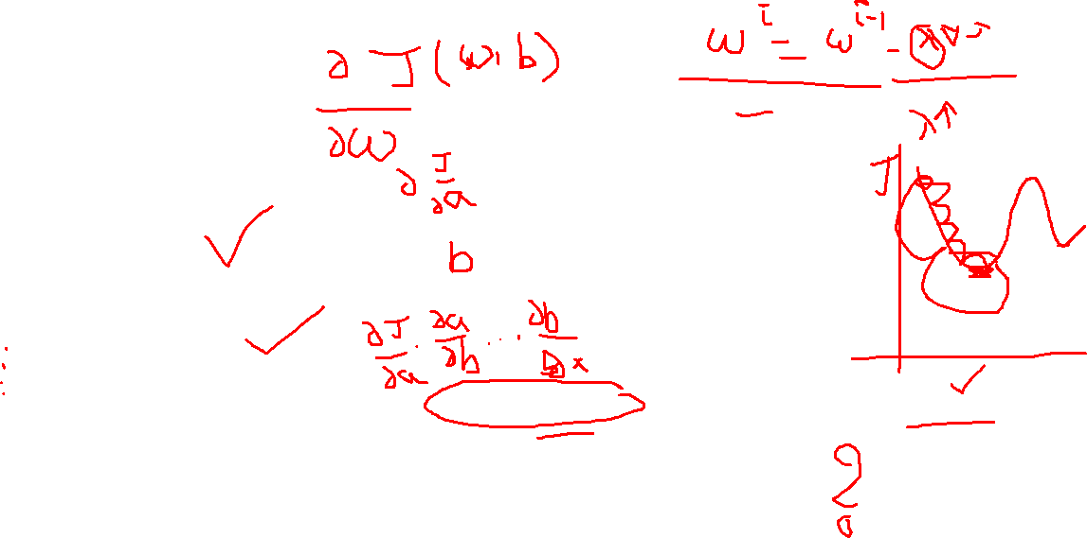
Applied ML is a highly iterative process
# layers
# hidden units learning rates activation functions
…
Idea
Experiment
Code

Slide 5
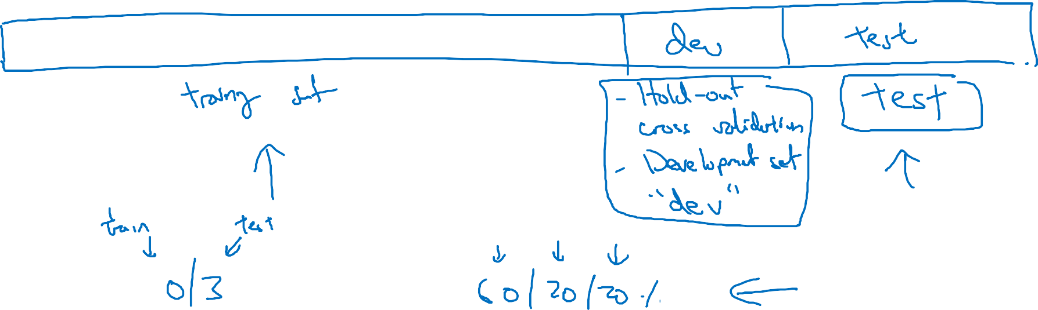










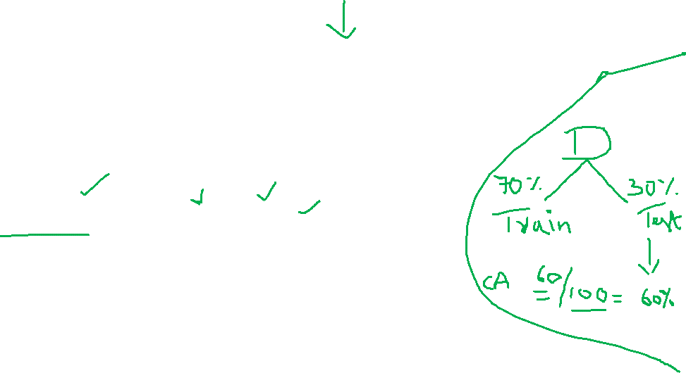
Train/dev/test sets

Slide 6














Mismatched train/test distribution
Training set:
Cat pictures from webpages
Dev/test sets:
Cat pictures from users using your app
Not having a test set might be okay. (Only dev set.)

Slide 7

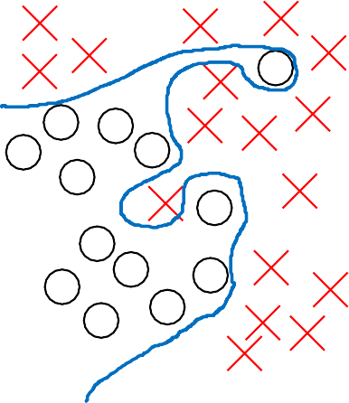







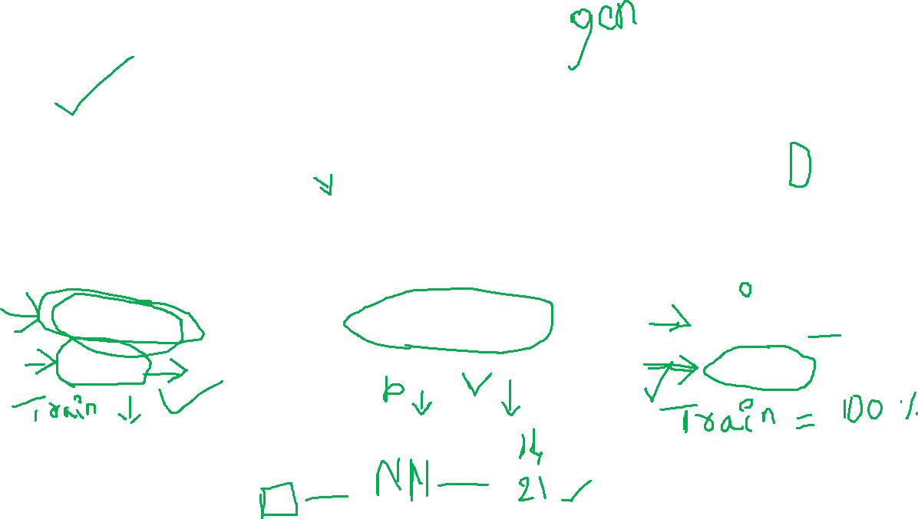
Bias and Variance
high bias
“just right”
high variance

Slide 8


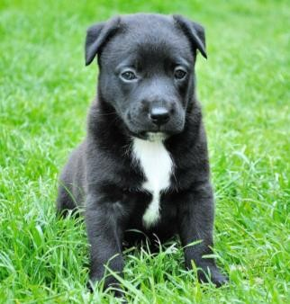
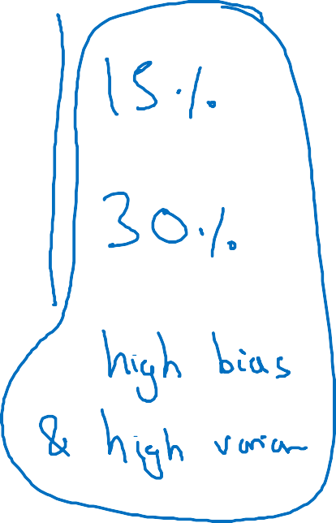











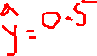
Bias and Variance
Cat classification
Train set error: Dev set error:

Slide 9
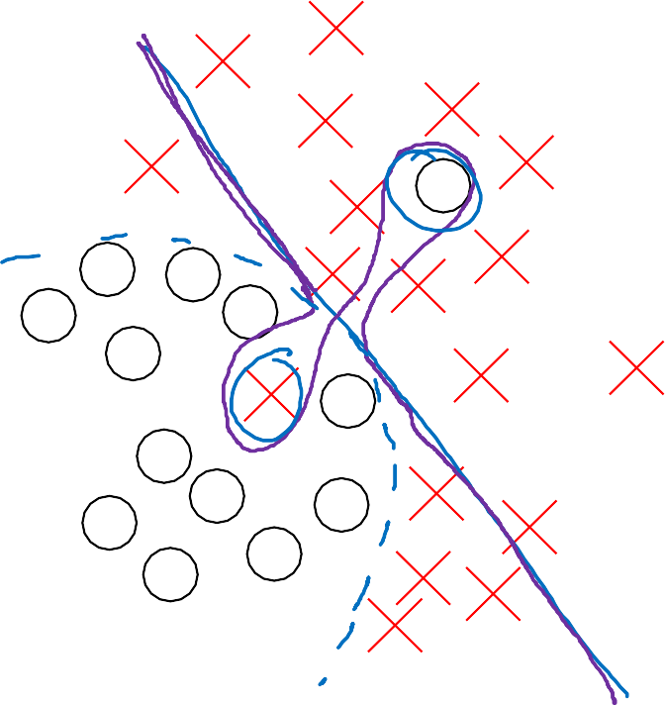

High bias and high variance
𝑥₂
𝑥₁

Slide 10
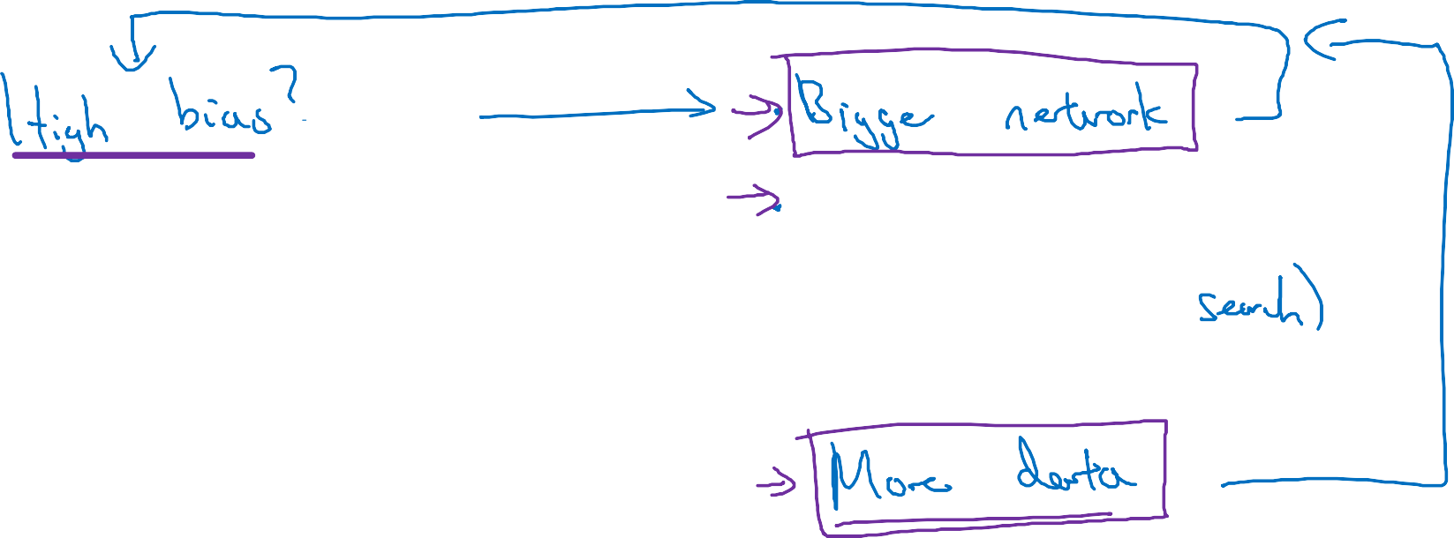




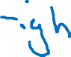















Basic recipe for machine learning

Slide 11
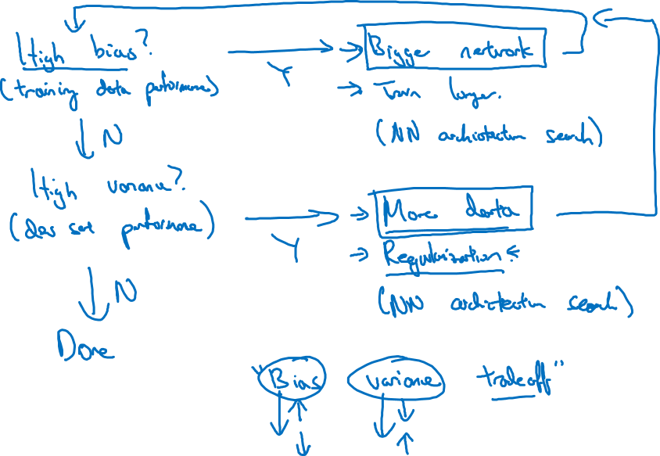

Basic recipe for machine learning

Slide 12
Regularizing your neural network
Regularization
deeplearning.ai

Slide 13




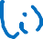













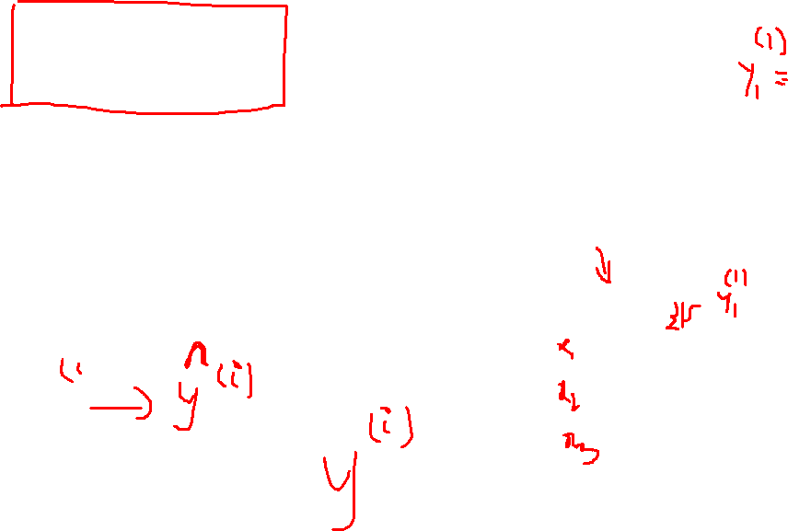
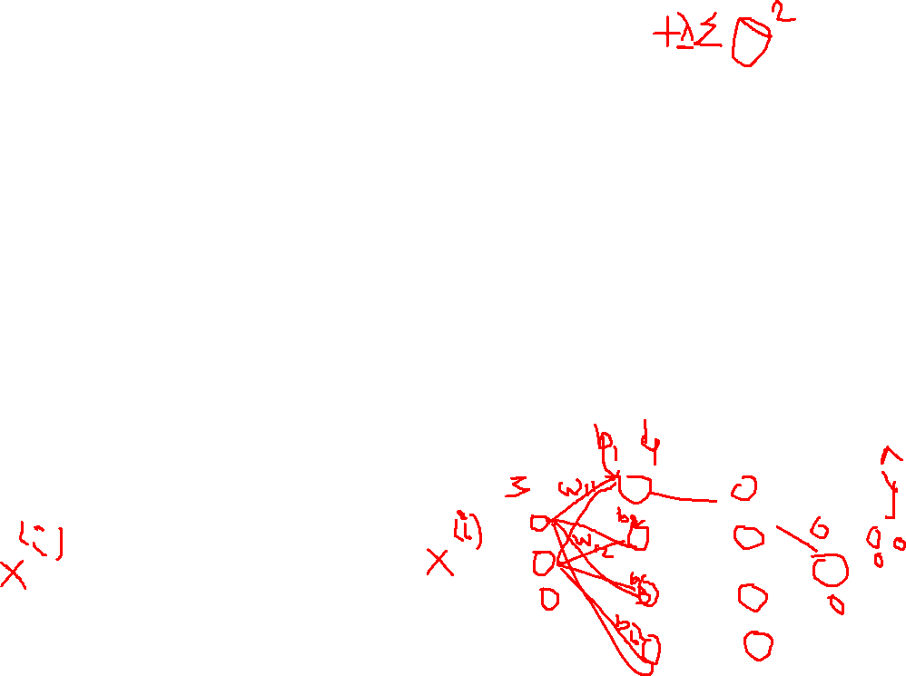
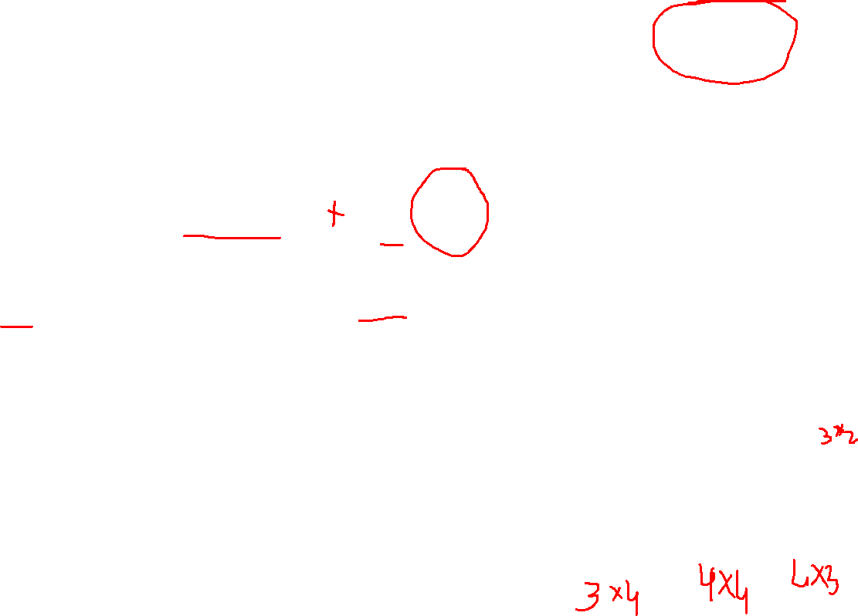
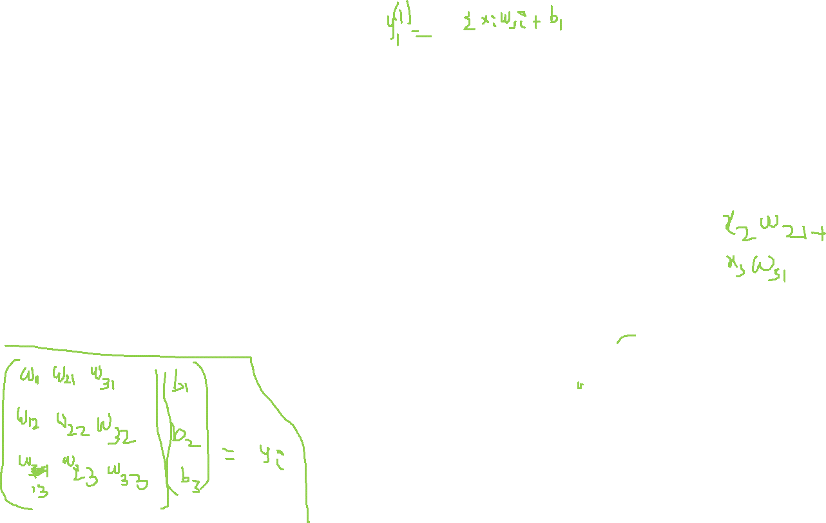

Logistic regression
min 𝐽(𝑤, 𝑏)
𝑤,𝑏

Slide 14












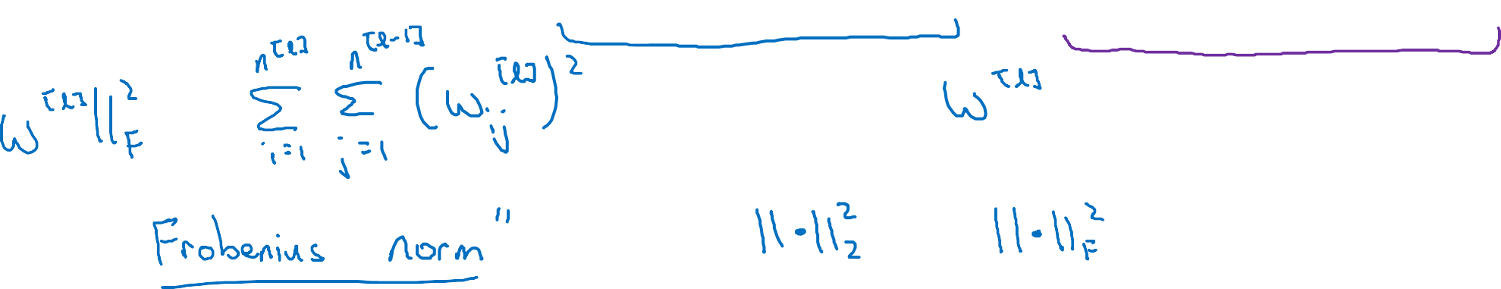



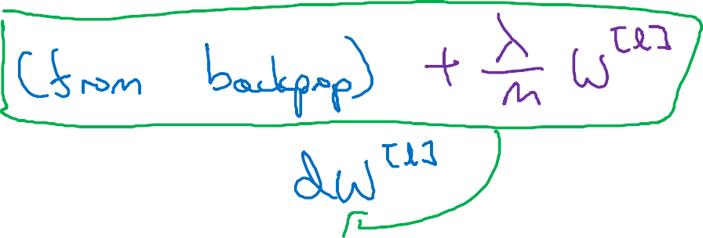






















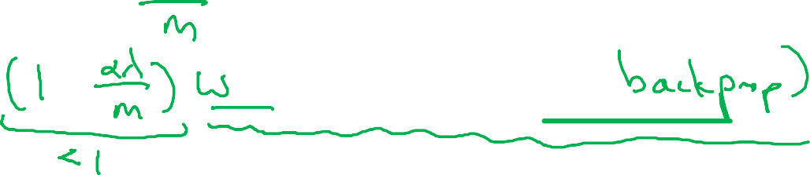

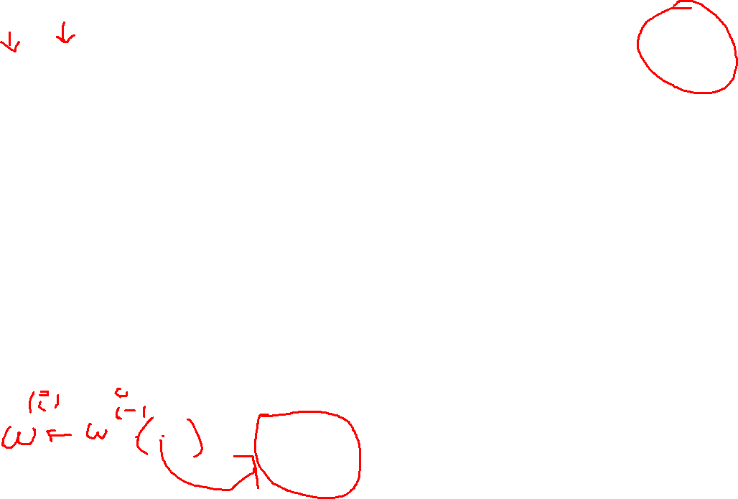
Neural network

Slide 15
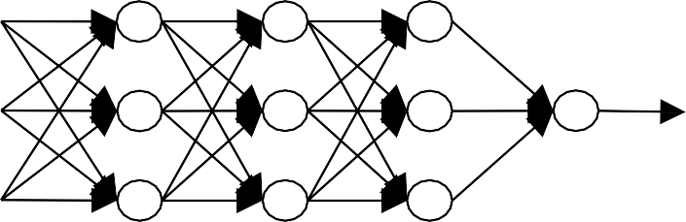
How does regularization prevent overfitting?
𝑥₁
𝑥₂
𝑥₃
𝑦
Andrew Ng

Slide 16
Regularizing your neural network
Why regularization reduces overfitting
deeplearning.ai

Slide 17
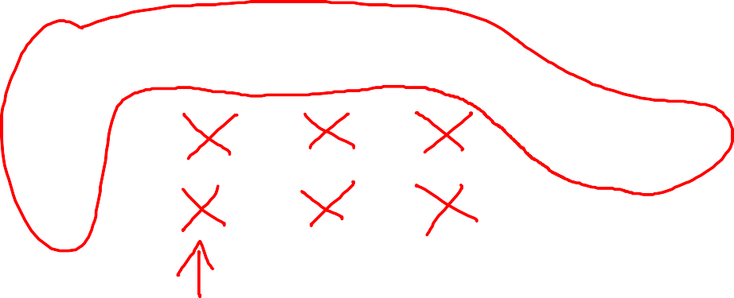






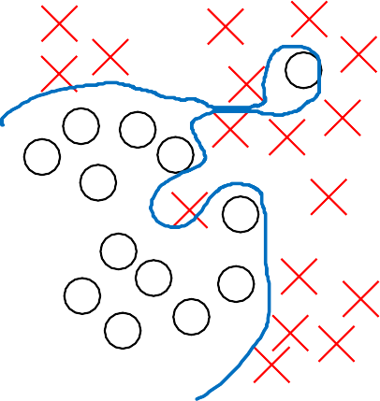

How does regularization prevent overfitting?
𝑥₁
𝑥₂
𝑥₃
𝑦
high bias
“just right”
high variance
Andrew Ng

Slide 18
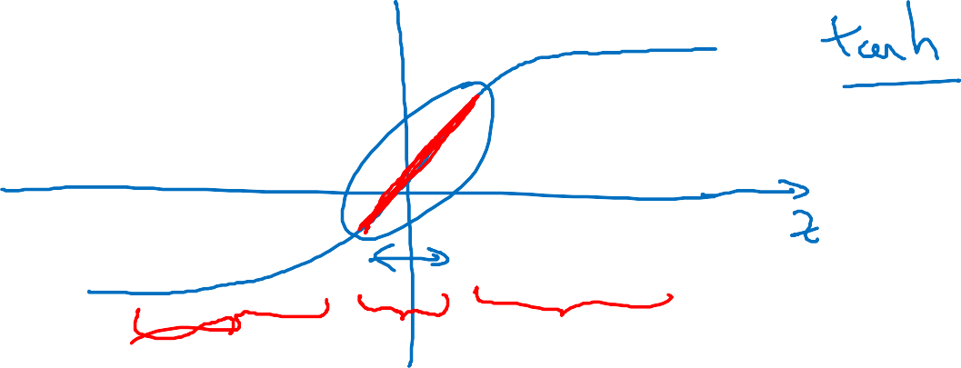












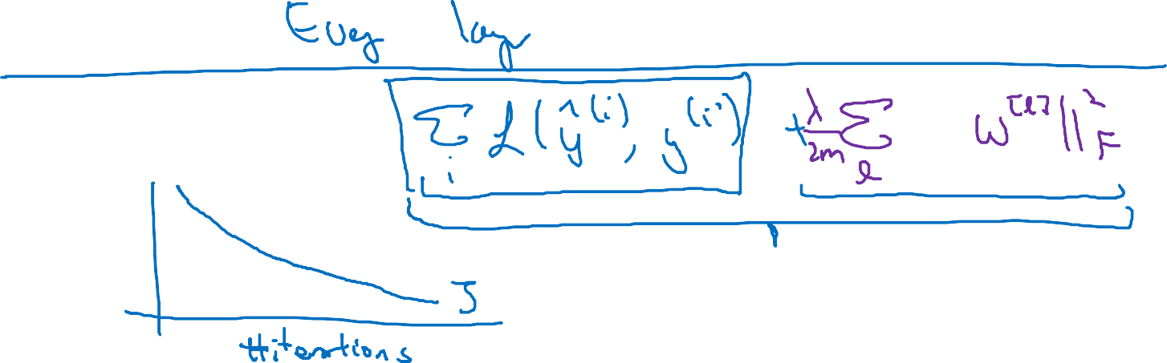


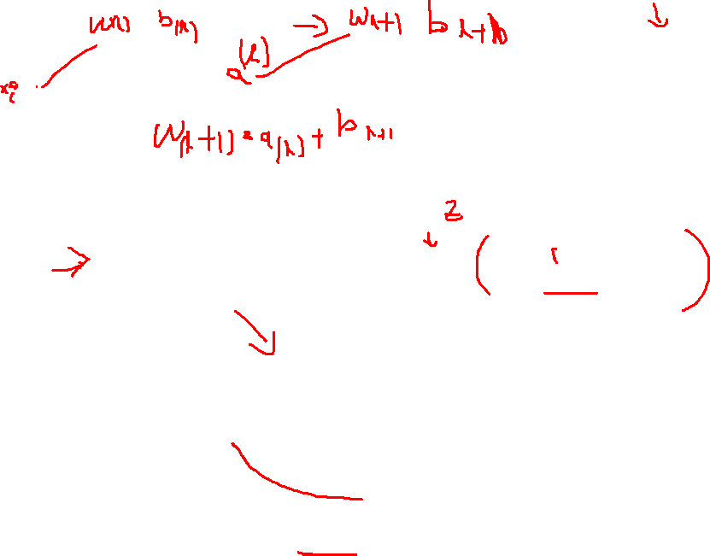
How does regularization prevent overfitting?
Andrew Ng

Slide 19
Regularizing your neural network
Dropout regularization
deeplearning.ai

Slide 20
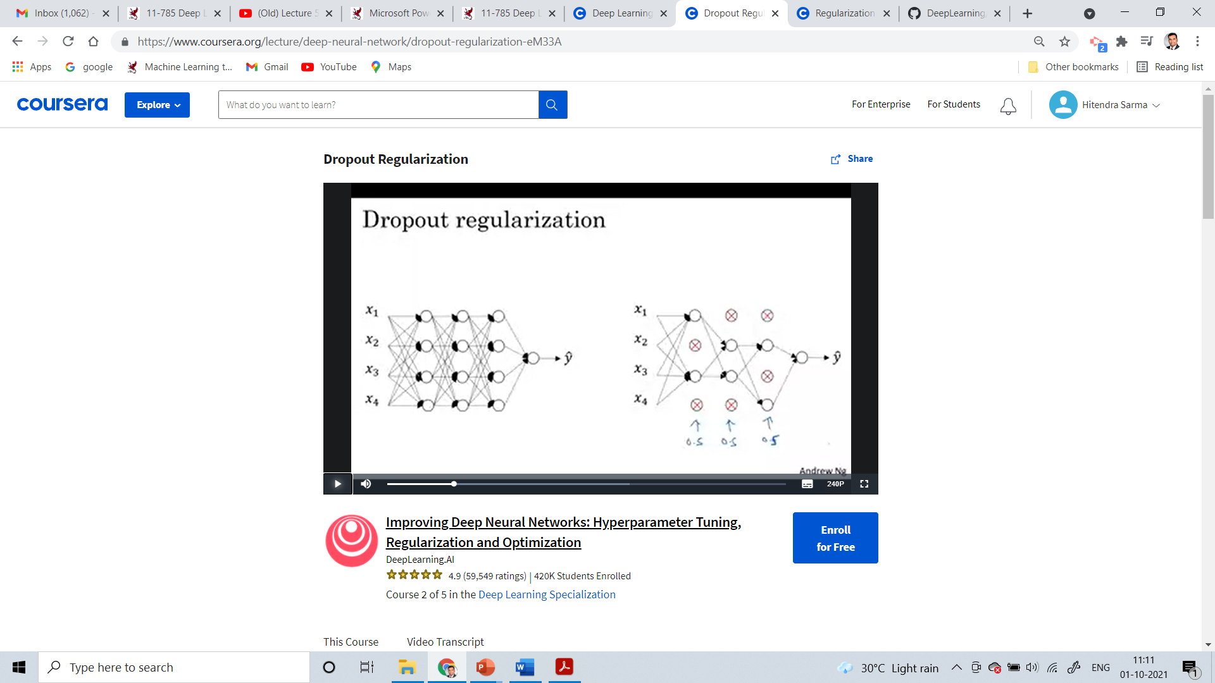



Dropout regularization
𝑥₁
𝑥₂
𝑦
𝑥
3
𝑥₄

Slide 21























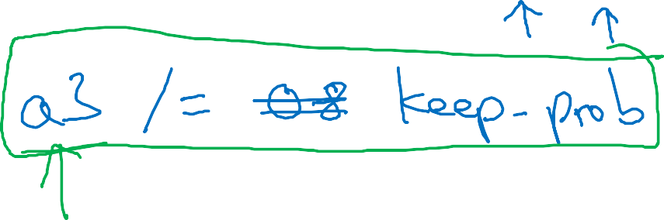















Implementing dropout (“Inverted dropout”)
Andrew Ng

Slide 22



















Making predictions at test time

Slide 23
Regularizing your neural network
Understanding dropout
deeplearning.ai

Slide 24




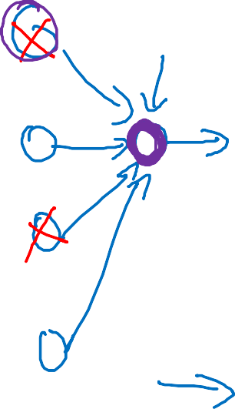










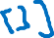



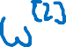




Why does drop-out work?
Intuition: Can’t rely on any one feature, so have to
spread out weights.
𝑥₁
𝑥₂
𝑥₃
𝑦
Andrew Ng

Slide 25
Regularizing your neural network
Other regularization methods
deeplearning.ai

Slide 26










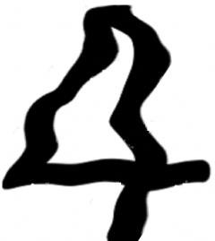

Data augmentation
4
Andrew Ng

Slide 27
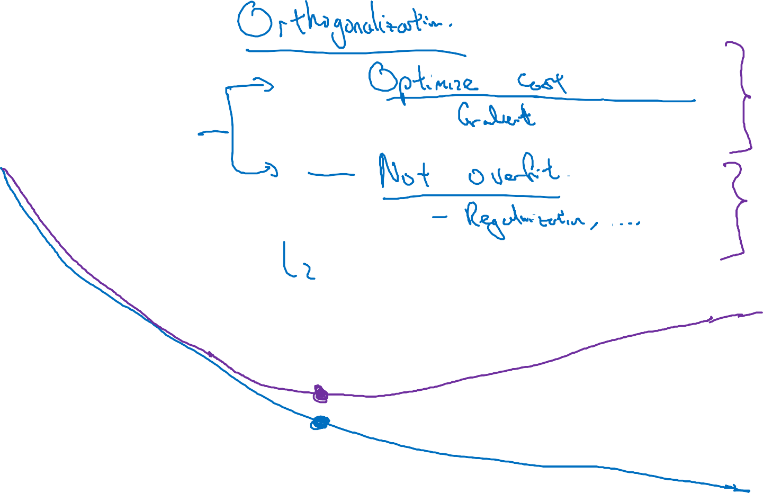












Early stopping
# iterations
Andrew Ng

Slide 28
Setting up your optimization problem
Normalizing inputs
deeplearning.ai

Slide 29

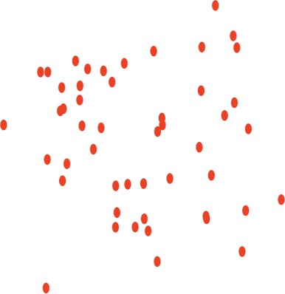
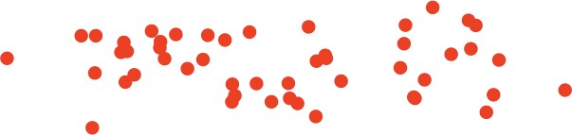

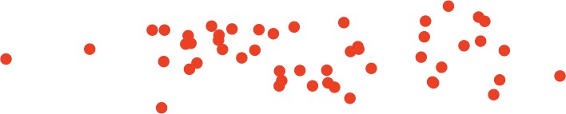




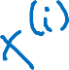













Normalizing training sets
𝑥₂
𝑥₂
3
𝑥₂
𝑥
𝑥
1
1
𝑥₁
5
Andrew Ng

Slide 30




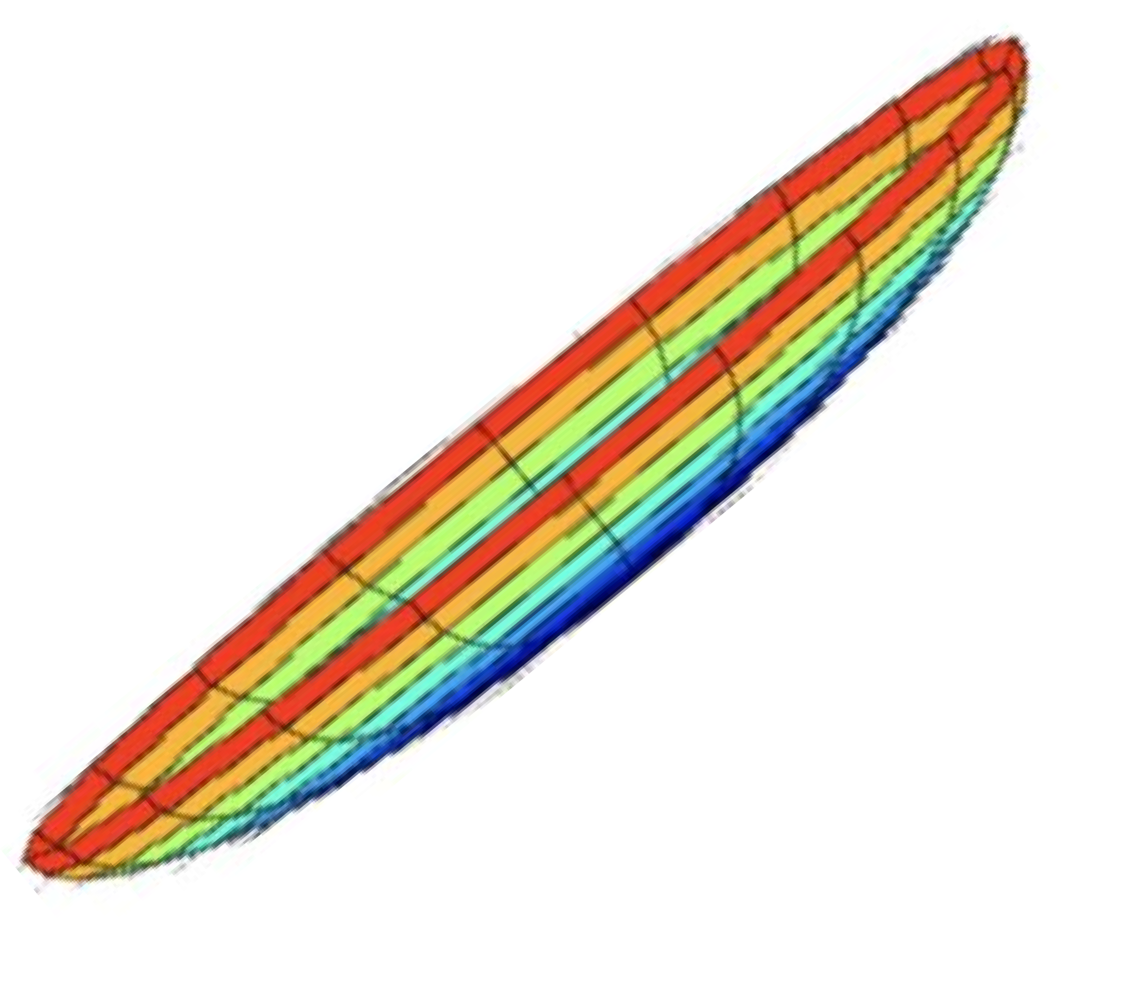
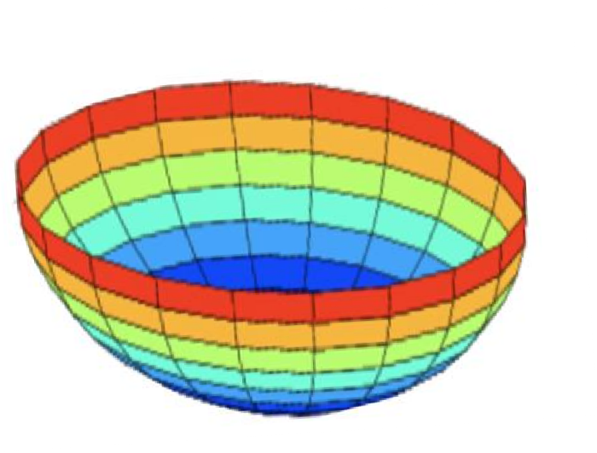



Why normalize inputs?
𝑚
෍
𝑚 𝑖=1
1
𝑖 (𝑖)
𝐽 𝑤, 𝑏 =
𝑓 (𝑦ො , 𝑦 )
Unnormalized:
Normalized:
𝐽
𝐽
𝑤
𝑤
𝑏
𝑏
𝑏
𝑏
𝑤
^{𝑤} Andrew Ng

Slide 31
Setting up your optimization problem
Vanishing/exploding gradients
deeplearning.ai

Slide 32
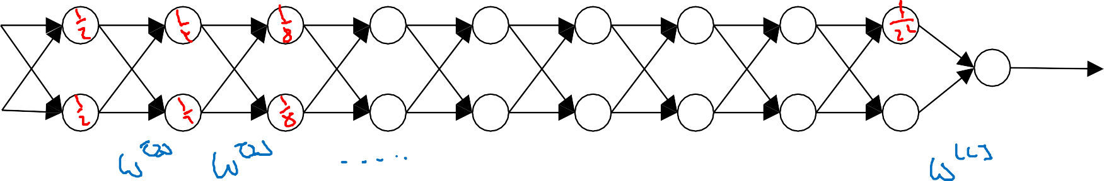

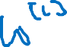



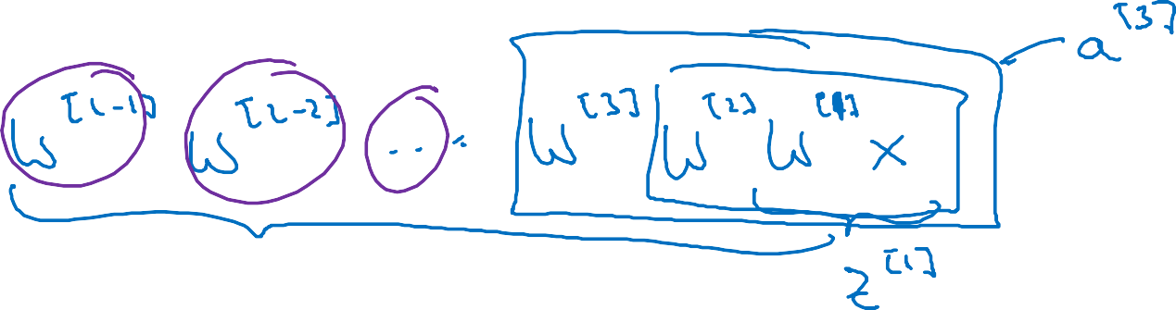



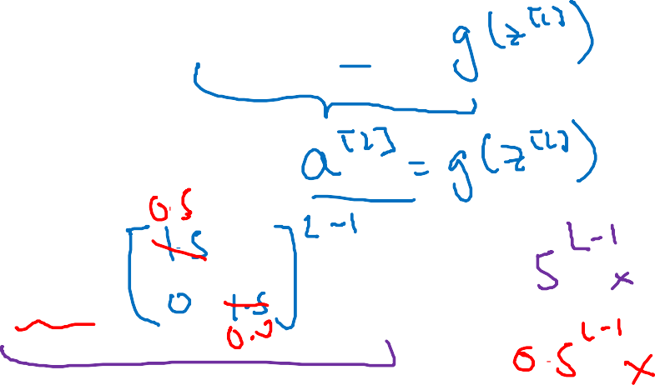




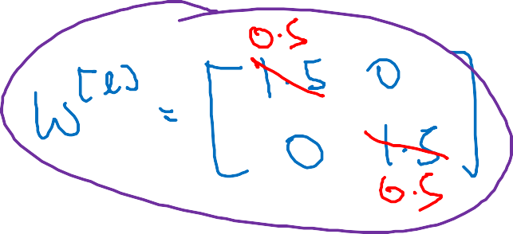


Vanishing/exploding gradients
𝑥₁
𝑥₂
𝑦ො
Andrew Ng

Slide 33

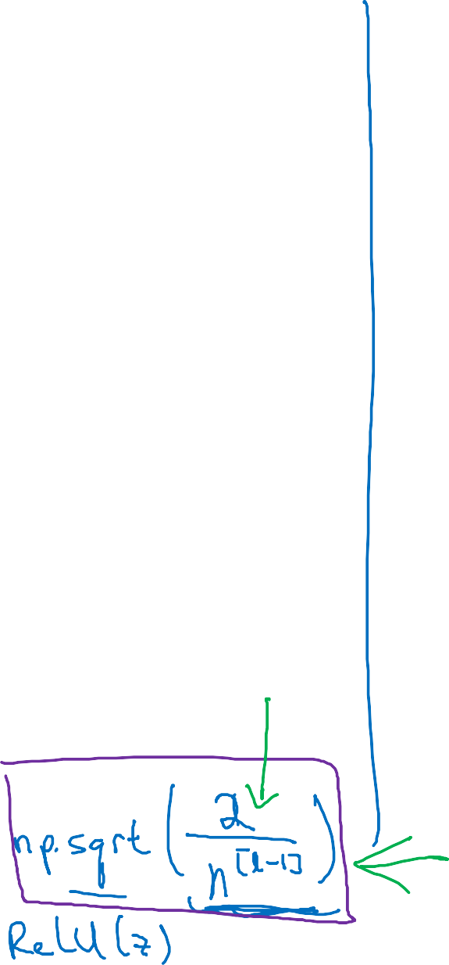


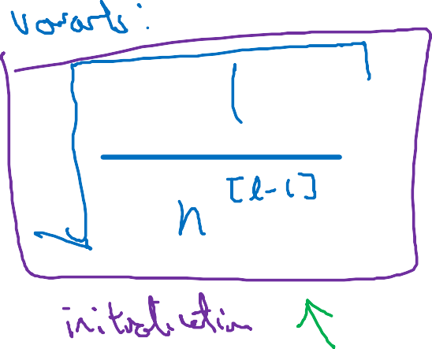


















Single neuron example
𝑥₁
𝑥₂
𝑥₃
𝑥₄
𝑦ො
𝑎 = 𝑔(𝑧)
Andrew Ng

Slide 34
Setting up your optimization problem
Numerical approximation of gradients
deeplearning.ai

Slide 35















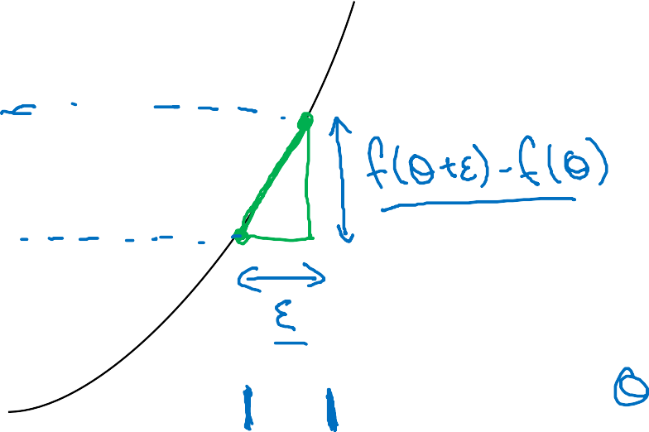



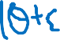












Checking your derivative computation
𝑓
Andrew Ng

Slide 36


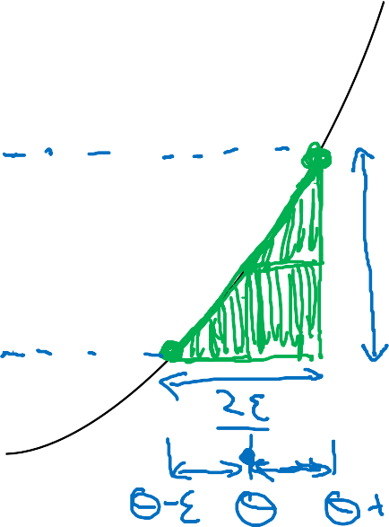


























Checking your derivative computation
𝑓
Andrew Ng

Slide 37
Setting up your optimization problem
Gradient Checking
deeplearning.ai

Slide 38







Gradient check for a neural network
Take 𝑊 ¹ , 𝑏^{[1]}, … , 𝑊 ^{𝐿} , 𝑏 ^{𝐿} and reshape into a big vector 𝜃.
Take 𝑑𝑊 ¹ , 𝑑𝑏^{[1]}, … , 𝑑𝑊 ^{𝐿} , 𝑑𝑏 ^{𝐿}
and reshape into a big vector d𝜃.
Andrew Ng

Slide 39









































Gradient checking (Grad check)
Andrew Ng

Slide 40
Setting up your optimization problem
Gradient Checking implementation notes
deeplearning.ai

Slide 41





















Gradient checking implementation notes
Don’t use in training – only to debug
If algorithm fails grad check, look at components to try to identify bug.
Remember regularization.
Doesn’t work with dropout.
Run at random initialization; perhaps again after some training.
Andrew Ng

